Slide 1
Graph Convolutional Neural Network

Slide 2
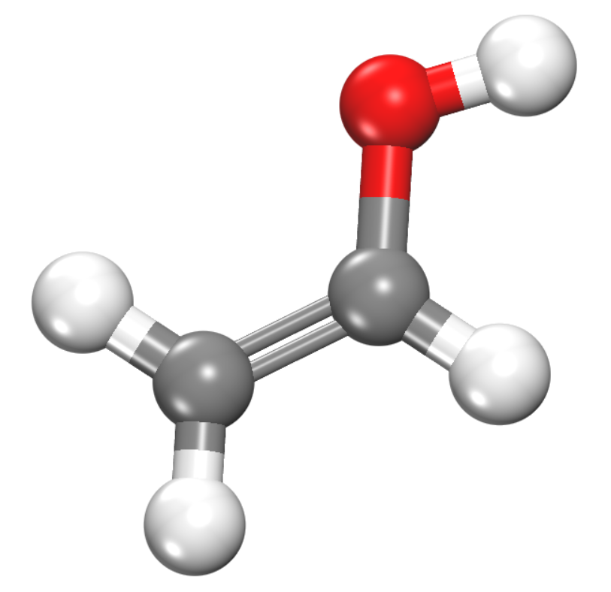
Properties of Molecules
Properties
Melting point -114.1℃
Boiling point 78 ℃
Δ_{f}Hº = -128 kJ/mol
Ethenol
Can we teach machine learning to predict these properties?

Slide 3
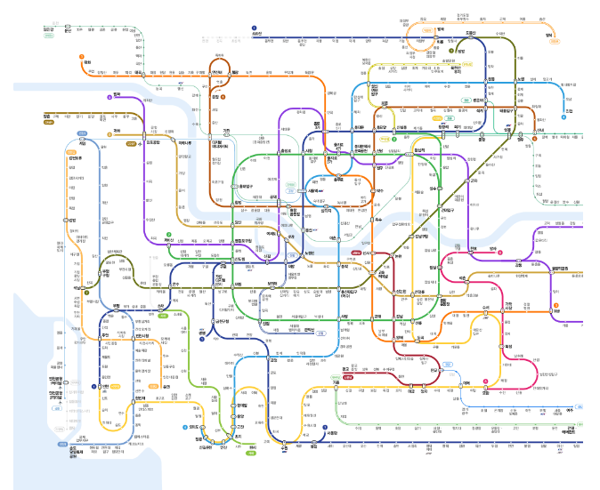
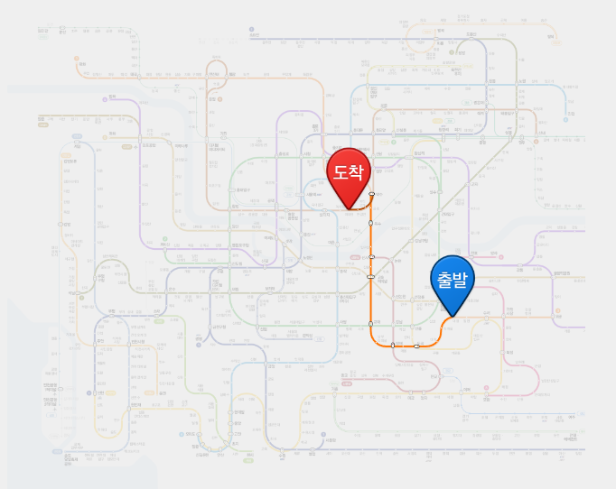
Graph Theory
Vertex: subway stations, edges: subway connections
Vertex
Edge
Graph theory technique is used to find the shortest path.

Slide 4
Molecular Graph Theory
H1
O1
Vertex = atoms
O1, C1, C2, H1, H2, H3, H4
Edges = bonds, or interaction
(O1-H1), (O1-C1),(C1-H2), (C1-C2),
(C2-H3), (C2-H4)
C1
H3
C2
H2
H4

Slide 5
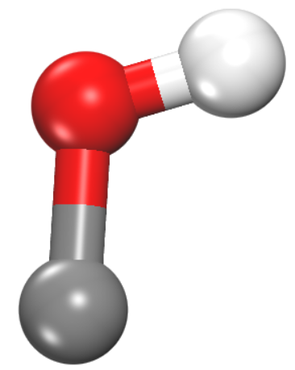
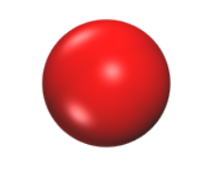
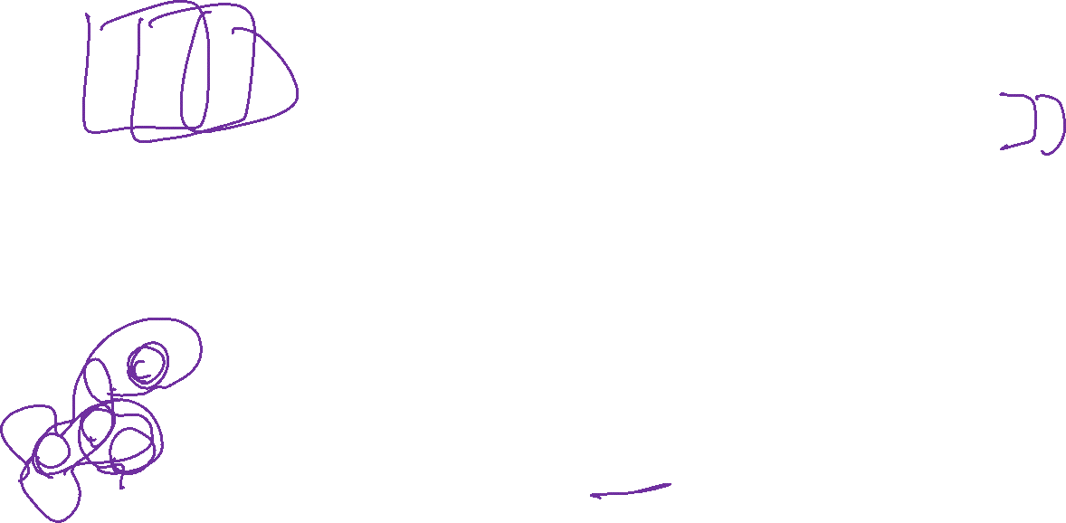
Graph Convolutional Neural Network
Convolutional Neural Network (Aggregate nearby pixels)
1 | 0 | 1 | 0 | 1 | 0
0 | 1 | 1 | 0 | 1 | 1
1 | 0 | 1 | 0 | 1 | 0
1 | 0 | 1 | 1 | 1 | 0
0 | 1 | 1 | 0 | 1 | 1
1 | 0 | 1 | 0 | 1 | 0
1 | 0 | 1
0 | 1 | 1
1 | 0 | 1
1 | 2 | 3
4 | 5 | 6
7 | 8 | 9
Sum
×
31
Image subpatch
Kernel
Graph Convolutional Neural Network (Aggregate neighbor atoms (and bonds))
Broadcast weight
0.3
0.2
0.5
5
5
5
Sum
×
5

Slide 6
Graph Convolution

Slide 7
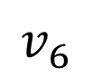
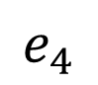
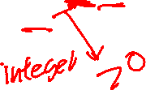
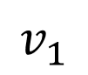
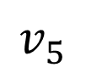
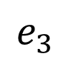
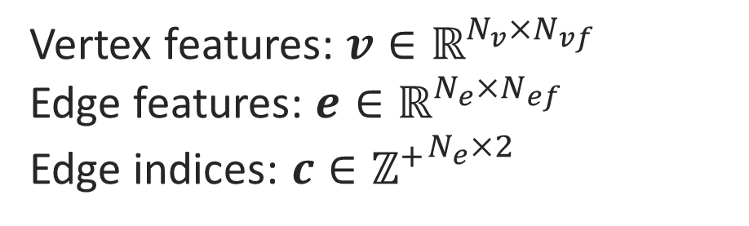
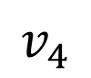
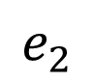
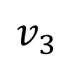
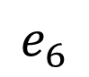
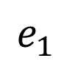
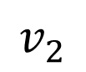
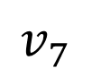
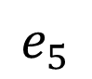
Molecular graph theory
$$v_{4}$$
$$e_{3}$$
$$v_{1}$$
Vertex features: $v∈ℝ^{N_{v}×N_{vf}}$
Edge features: $e∈ℝ^{N_{e}×N_{ef}}$
Edge indices: $c∈{ℤ^{+}}^{N_{e}×2}$
$$e_{1}$$
$$v_{7}$$
$$v_{2}$$
$$e_{5}$$
$$e_{2}$$
$$e_{4}$$
$$v_{3}$$
$$v_{5}$$
$$e_{6}$$
$$v_{6}$$

Slide 8
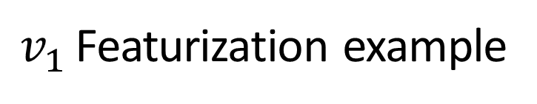
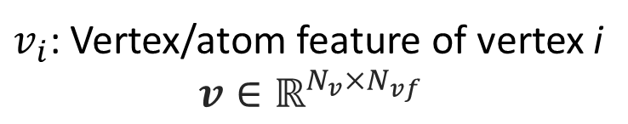
Vertex features
$$v_{4}$$
$v_{i}$: Vertex/atom feature of vertex i
$$v∈ℝ^{N_{v}×N_{vf}}$$
$$e_{3}$$
$$v_{1}$$
$v_{1}$ Featurization example
$$e_{1}$$
Symbol Oxygen [1,0,0]
Hybridization sp³ [1,0,0,0]
Degree 2 [2]
# H neighbor 1 [1]
Aromaticity False [0]
Ring size 0 [0]
Formal charge 0 [0]
$$v_{7}$$
$$v_{2}$$
$$e_{5}$$
$$e_{2}$$
$$e_{4}$$
$$v_{3}$$
$$v_{5}$$
$$e_{6}$$
$$v_{6}$$
Concatenate
[1,0,0,1,0,0,0,2,1,0,0,0]

Slide 9
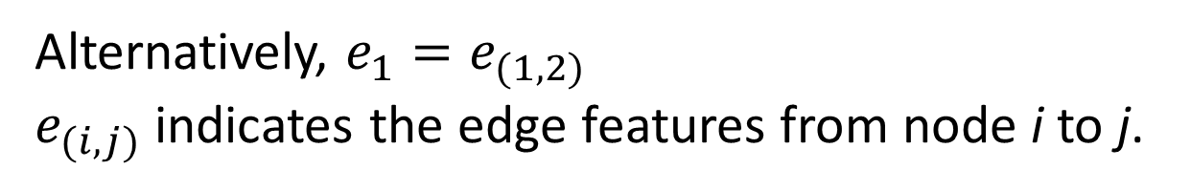
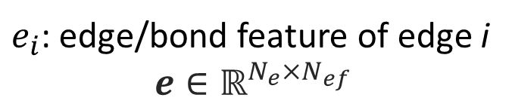
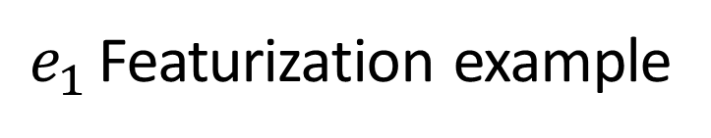
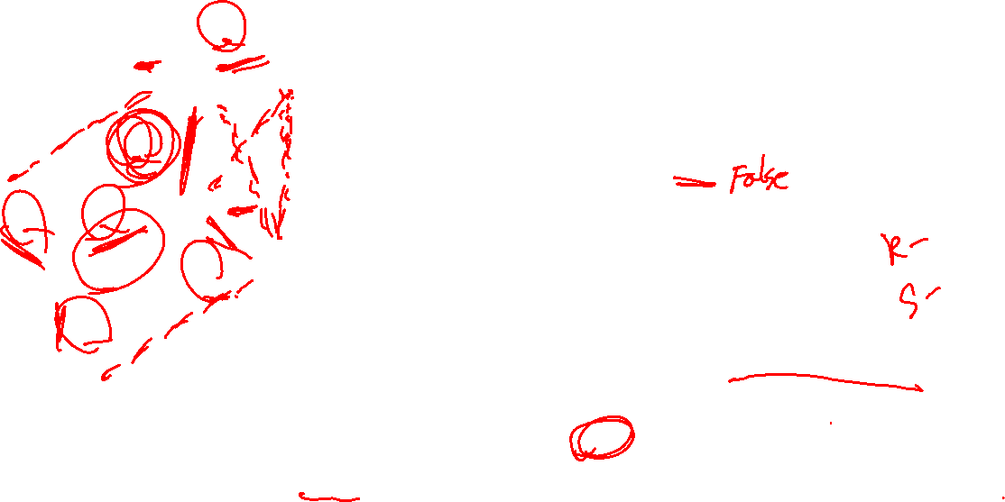
Edge features
$$v_{4}$$
$e_{i}$: edge/bond feature of edge i
$$e∈ℝ^{N_{e}×N_{ef}}$$
$$e_{3}$$
$$v_{1}$$
$e_{1}$ Featurization example
$$e_{1}$$
Bond type Single [1,0,0,0]
Conjugated True [0]
Stereochemistry False [0]
Ring size 0 [0]
$$v_{7}$$
$$v_{2}$$
$$e_{5}$$
$$e_{2}$$
$$e_{4}$$
$$v_{3}$$
$$v_{5}$$
$$e_{6}$$
Concatenate
[1,0,0,0,0,0,0]
$$v_{6}$$
Alternatively, $e_{1}=e_{(1,2)}$
$e_{(i,j)}$ indicates the edge features from node i to j.

Slide 10
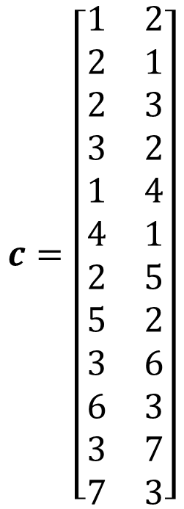
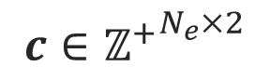
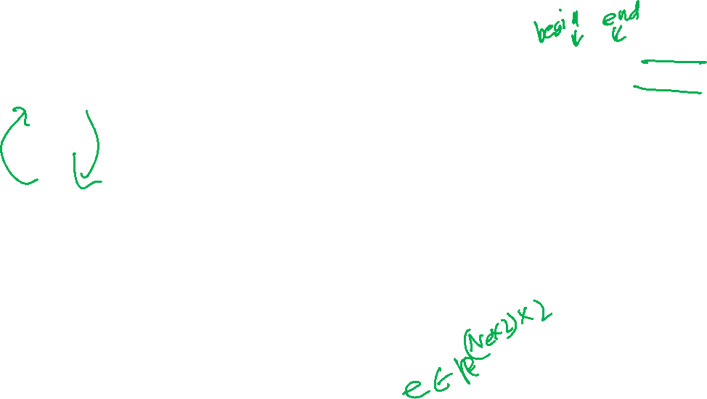
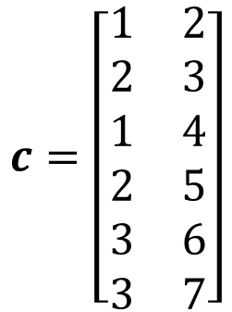
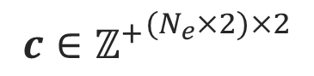
Edge index
$$v_{4}$$
Index of two atom connected by edge
$$e_{3}$$
$$v_{1}$$
$$c=\left[\begin{matrix}1 & 2 \\ 2 & 1 \\ 2 & 3 \\ 3 & 2 \\ 1 & 4 \\ 4 & 1 \\ 2 & 5 \\ 5 & 2 \\ 3 & 6 \\ 6 & 3 \\ 3 & 7 \\ 7 & 3\end{matrix}\right]$$
forward
backward
$$c=\left[\begin{matrix}1 & 2 \\ 2 & 3 \\ 1 & 4 \\ 2 & 5 \\ 3 & 6 \\ 3 & 7\end{matrix}\right]$$
forward
$$e_{1}$$
backward
$$v_{7}$$
$$v_{2}$$
…
$$e_{5}$$
$$e_{2}$$
$$e_{4}$$
$$v_{3}$$
$$v_{5}$$
$$c∈{ℤ^{+}}^{N_{e}×2}$$
$$e_{6}$$
For undirected graph
$$v_{6}$$
$$c∈{ℤ^{+}}^{(N_{e}×2)×2}$$
For directed graph

Slide 11
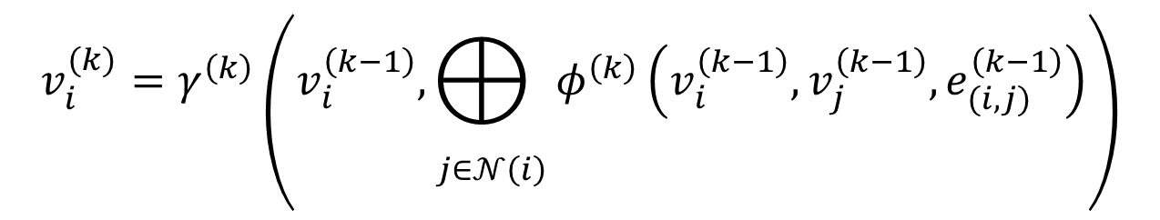
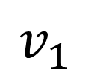
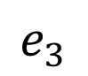
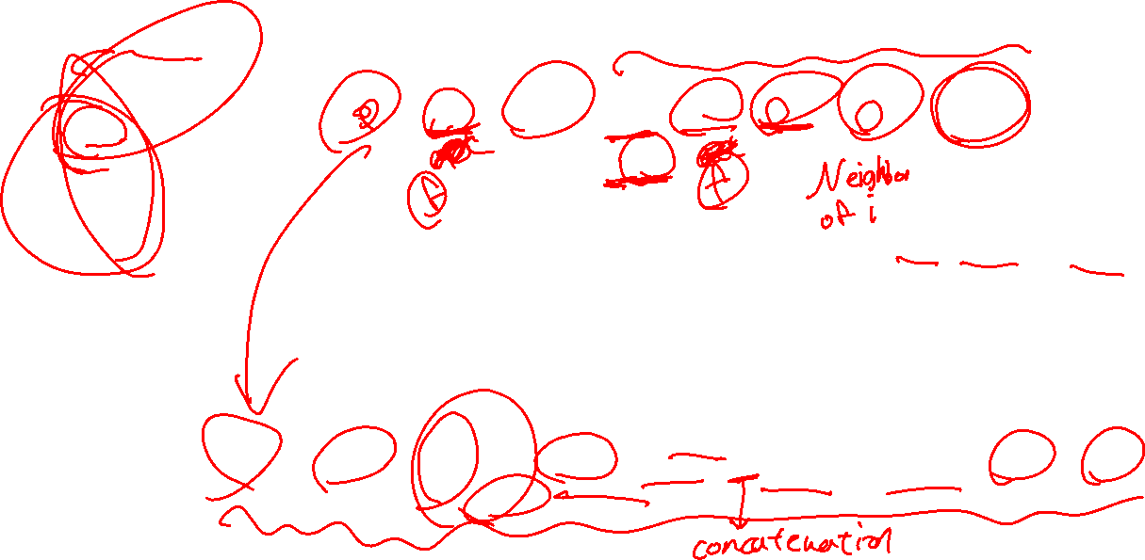
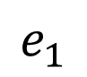
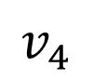
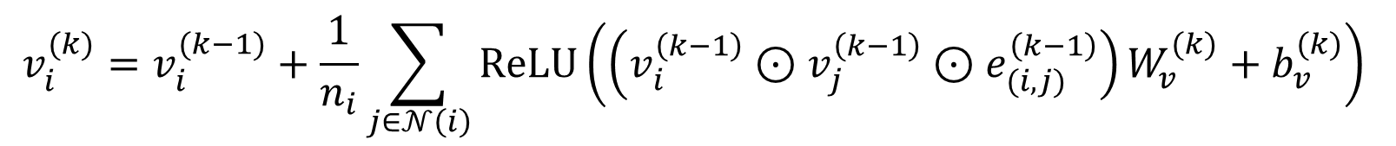
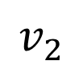
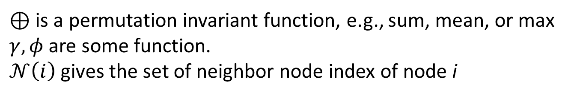
Vertex convolution
Node convolution has a general form:
$$v_{4}$$
$$e_{3}$$
$$v_{i}^{(k)}=γ^{\left(k\right)}\left(v_{i}^{\left(k−1\right)},\underset{j∈𝒩\left(i\right)}{⨁{ }}φ^{\left(k\right)}\left(v_{i}^{\left(k−1\right)},v_{j}^{\left(k−1\right)},e_{(i,j)}^{\left(k−1\right)}\right)\right)$$
$$v_{1}$$
$$e_{1}$$
$$v_{2}$$
$⊕$ is a permutation invariant function, e.g., sum, mean, or max
$γ,φ$ are some function.
$𝒩\left(i\right)$ gives the set of neighbor node index of node i
Neighboring edges and vertex is aggregated
$$v_{i}^{(k)}=v_{i}^{(k−1)}+\frac{1}{n_{i}}\sum_{j∈𝒩\left(i\right)}{ReLU\left(\left(v_{i}^{\left(k−1\right)}⊙v_{j}^{\left(k−1\right)}⊙e_{(i,j)}^{\left(k−1\right)}\right)W_{v}^{(k)}+b_{v}^{(k)}\right)}$$
For example:

Slide 12
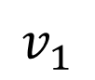
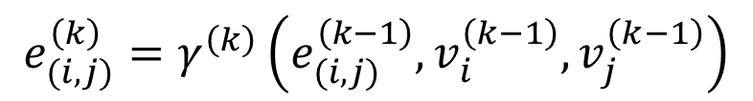
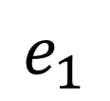
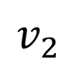
Edge convolution
Edge convolution has a general form:
$$v_{1}$$
$$e_{(i,j)}^{\left(k\right)}=γ^{\left(k\right)}\left(e_{(i,j)}^{\left(k−1\right)},v_{i}^{\left(k−1\right)},v_{j}^{\left(k−1\right)}\right)$$
$$e_{1}$$
Neighboring vertex is aggregated
$$v_{2}$$
For example:
$$e_{i}^{(k)}=e_{i}^{(k−1)}+ReLU\left(\left(e_{(i,j)}^{\left(k−1\right)}⨀v_{i}^{\left(k−1\right)}⨀v_{j}^{\left(k−1\right)}\right)W_{e}^{(k)}+b_{e}^{(k)}\right)$$

Slide 13
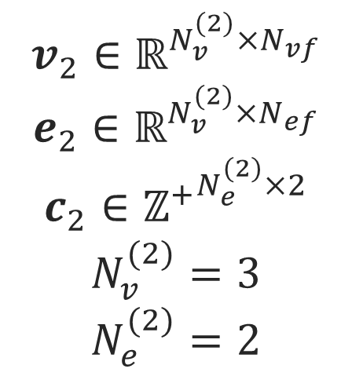
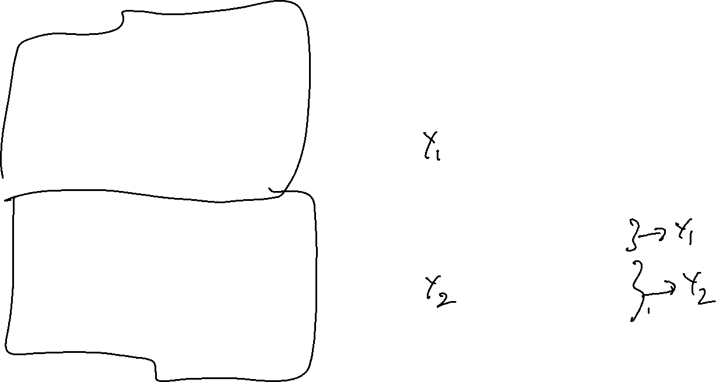
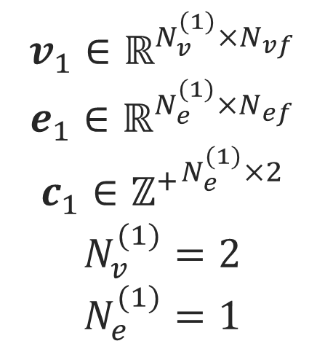
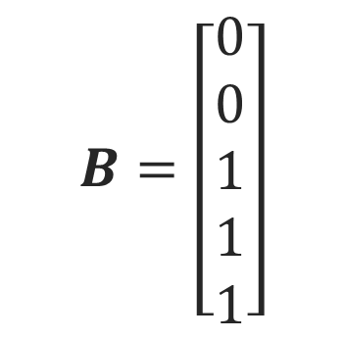
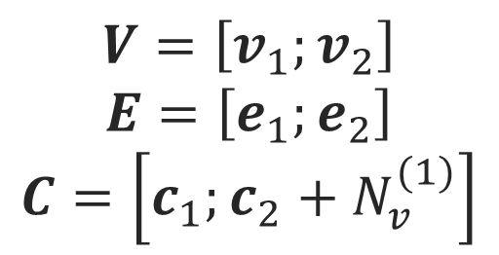
Batch Consideration
Data
Mini-batch Data
$$v_{1}∈ℝ^{N_{v}^{(1)}×N_{vf}}$$
$$e_{1}∈ℝ^{N_{e}^{(1)}×N_{ef}}$$
$$c_{1}∈{ℤ^{+}}^{N_{e}^{(1)}×2}$$
$$N_{v}^{(1)}=2$$
$$N_{e}^{(1)}=1$$
0
1
0
1
$$V=\left[v_{1};v_{2}\right]$$
$$E=\left[e_{1};e_{2}\right]$$
$$C=\left[c_{1};c_{2}+N_{v}^{(1)}\right]$$
3
1
Graph index of nodes
$$v_{2}∈ℝ^{N_{v}^{(2)}×N_{vf}}$$
$$e_{2}∈ℝ^{N_{v}^{(2)}×N_{ef}}$$
$$c_{2}∈{ℤ^{+}}^{N_{e}^{(2)}×2}$$
$$N_{v}^{(2)}=3$$
$$N_{e}^{(2)}=2$$
$$B=\left[\begin{matrix}0 \\ 0 \\ 1 \\ 1 \\ 1\end{matrix}\right]$$
2
4
0
2

Slide 14





Example Model Architecture
$$V$$
$$E$$
$$C$$
$$B$$
Dense
Dense
Dense: a regular neural network
V Conv: vertex convolution
E conv: edge convolution
Linear: linear multiplication
V Conv
E Conv
V Conv
E Conv
V Conv
Dense
Linear
Mean Pool
Heat of formation…

Slide 15
Rdkit-based Molecular Graph Theory

Slide 16









SMILES string
C
CC
CCC
C=C
C#C
C1CCCCC1
c1ccccc1
CC=O

Slide 17


Rdkit
from rdkit import Chem
mol = Chem.MolFromSmiles('CC=O')
mol
>>>
for atom in mol.GetAtoms():
print(atom.GetIdx(),atom.GetSymbol())
>>> 0 C
>>> 1 C
>>> 2 O
for bond in mol.GetBonds():
print(bond.GetBeginAtomIdx(),\
bond.GetEndAtomIdx(),bond.GetBondType())
>>> 0 1 SINGLE
>>> 1 2 DOUBLE
mol = Chem.MolFromSmiles('C=O')
mol = Chem.AddHs(mol)
for atom in mol.GetAtoms():
print(atom.GetIdx(),atom.GetSymbol())
>>> 0 C
>>> 1 O
>>> 2 H
>>> 3 H
Atom Method:
ClearProp, DescribeQuery, GetAtomMapNum, GetAtomicNum, GetBonds, GetBoolProp, GetChiralTag, GetDegree, GetDoubleProp, GetExplicitBitVectProp, GetExplicitValence, GetFormalCharge, GetHybridization, GetIdx, GetImplicitValence, GetIntProp, GetIsAromatic, GetIsotope, GetMass, GetMonomerInfo, GetNeighbors, GetNoImplicit, GetNumExplicitHs, GetNumImplicitHs, GetNumRadicalElectrons, GetOwningMol, GetPDBResidueInfo, GetProp, GetPropNames, GetPropsAsDict, GetQueryType, GetSmarts, GetSymbol, GetTotalDegree, GetTotalNumHs, GetTotalValence, GetUnsignedProp, HasOwningMol, HasProp, HasQuery, InvertChirality, IsInRing, IsInRingSize, Match, NeedsUpdatePropertyCache, SetAtomMapNum, SetAtomicNum, SetBoolProp, SetChiralTag, SetDoubleProp, SetExplicitBitVectProp, SetFormalCharge, SetHybridization, SetIntProp, SetIsAromatic, SetIsotope, SetMonomerInfo, SetNoImplicit, SetNumExplicitHs, SetNumRadicalElectrons, SetPDBResidueInfo, SetProp, SetUnsignedProp, UpdatePropertyCache
https://www.rdkit.org/docs/source/rdkit.Chem.rdchem.html#rdkit.Chem.rdchem.Atom
Bond Method:
ClearProp, DescribeQuery, GetBeginAtom, GetBeginAtomIdx, GetBondDir, GetBondType, GetBondTypeAsDouble, GetBoolProp, GetDoubleProp, GetEndAtom, GetEndAtomIdx, GetIdx, GetIntProp, GetIsAromatic, GetIsConjugated, GetOtherAtom, GetOtherAtomIdx, GetOwningMol, GetProp, GetPropNames, GetPropsAsDict, GetSmarts, GetStereo, GetStereoAtoms, GetUnsignedProp, GetValenceContrib, HasOwningMol, HasProp, HasQuery, IsInRing, IsInRingSize, Match, SetBondDir, SetBondType, SetBoolProp, SetDoubleProp, SetIntProp, SetIsAromatic, SetIsConjugated, SetProp, SetStereo, SetStereoAtoms, SetUnsignedProp
https://www.rdkit.org/docs/source/rdkit.Chem.rdchem.html#rdkit.Chem.rdchem.Bond

Slide 18


Rdkit-based data pre-processing
2
1
import torch
from rdkit import Chem
mol = Chem.MolFromSmiles('C=O')
mol = Chem.AddHs(mol)
# one hot encoding atom feature
oh_atom = ['C', 'O', 'H']
v = []
for atom in mol.GetAtoms():
oh = [0 for _ in oh_atom]
oh[oh_atom.index(atom.GetSymbol())] = 1
v.append(oh)
v = torch.tensor(v)
# one hot encoding bond feature and edge_index
oh_bond = ['SINGLE', 'DOUBLE', 'TRIPLE', 'AROMATIC']
e = []
c= []
for bond in mol.GetBonds():
oh = [0 for _ in oh_bond]
oh[oh_bond.index(str(bond.GetBondType()))] = 1
e.append(oh)
c.append([bond.GetBeginAtomIdx(),bond.GetEndAtomIdx()])
e = torch.tensor(e)
c = torch.tensor(c,dtype=torch.long)
0
3
v = tensor([[1, 0, 0],
[0, 1, 0],
[0, 0, 1],
[0, 0, 1]])
e = tensor([[0, 1, 0, 0],
[1, 0, 0, 0],
[1, 0, 0, 0]])
c = tensor([[0, 1],
[0, 2],
[0, 3]])

Slide 19
GCNN Architectures

Slide 20






Case study

Slide 21



Case study

Slide 22





Case study

Slide 23

Open Catalyst Database
Open Catalyst 2020
~264 million DFT data points
(Transition metal catalysts)
Open Catalyst 2022
~10 million DFT data points
(Transition metal oxide catalysts)
Materials Project Trajectory
~50 million DFT data points
(Crystals)
Ulissi and coworkers. ACS Catal. 2021, 11, 6059; ACS Catal. 2023, 13, 3066

Slide 24

Gemnet-oc model

Slide 25


Single Graph Data Example
import torch
from torch_geometric.data import Data
edge_index = torch.tensor([[0, 1, 1, 2],
[1, 0, 2, 1]], dtype=torch.long)
x = torch.tensor([[-1], [0], [1]], dtype=torch.float)
edge_attr = torch.tensor([[0],
[1]], dtype=torch.float)
y = torch.tensor([-3.4],dtype=torch.float)
data = Data(x=x, edge_index=edge_index,edge_attr=edge_attr, y=y)
data.x: Node feature matrix with shape [num_nodes, num_node_features]
data.edge_index: Graph connectivity in COO format with shape [2, num_edges] and type torch.long
data.edge_attr: Edge feature matrix with shape [num_edges, num_edge_features]
data.y: Target to train against (may have arbitrary shape), e.g., node-level targets of shape [num_nodes, *] or graph-level targets of shape [1, *]
data.pos: Node position matrix with shape [num_nodes, num_dimensions]
and any attributes of your choice
https://pytorch-geometric.readthedocs.io/en/latest/get_started/introduction.html

Slide 26

Dataset Example
import torch
from torch_geometric.data import Dataset, download_url
class MyOwnDataset(Dataset):
def __init__(self, root, transform=None, pre_transform=None, pre_filter=None):
super().__init__(root, transform, pre_transform, pre_filter)
@property
def raw_file_names(self):
return ['some_file_1', 'some_file_2', ...]
@property
def processed_file_names(self):
return ['data_1.pt', 'data_2.pt', ...]
def download(self):
# Download to `self.raw_dir`.
path = download_url(url, self.raw_dir)
def process(self):
idx = 0
for raw_path in self.raw_paths:
# Read data from `raw_path`.
data = Data(...)
if self.pre_filter is not None and not self.pre_filter(data):
continue
if self.pre_transform is not None:
data = self.pre_transform(data)
torch.save(data, osp.join(self.processed_dir, f'data_{idx}.pt'))
idx += 1
def len(self):
return len(self.processed_file_names)
def get(self, idx):
data = torch.load(osp.join(self.processed_dir, f'data_{idx}.pt'))
return data
The parent class needs to be initialized with
root – directory where files will be stored
transform – (optional) transform data before accessing (data augmentation)
pre_transform – (optional) transformation before being saved to the disk (heavy precomputation)
pre_filter – (optional) for filtering out data before saving
Following methods need to implemented:
raw_file_names – (optional) A list of files which needs to be found in order to skip downloading files.
processed_file_name – (optional) A list of files which needs to be found in order to skip processing
download – (optional) method for downloading raw_files
process – (optional) method for processing raw_files
len – return length of data
get – method for getting the “idx” index of the data. (single graph/torch_geometric.data.Data)
Use torch_geometric.loader.DataLoader
https://pytorch-geometric.readthedocs.io/en/latest/tutorial/create_dataset.html

Slide 27





Neural Network Example
import torch
import torch.nn.functional as F
from torch_geometric.nn import GCNConv
from torch_geometric.nn.pool import global_mean_pool
class GCN(torch.nn.Module):
def __init__(self):
super().__init__()
self.conv1 = GCNConv(dataset.num_node_features, 16)
self.conv2 = GCNConv(16, 1)
def forward(self, data):
x, edge_index = data.x, data.edge_index
x = self.conv1(x, edge_index)
x = F.relu(x)
x = self.conv2(x, edge_index)
y = global_mean_pool(x,data.batch)
return y
device = torch.device('cuda' if torch.cuda.is_available() else 'cpu')
model = GCN().to(device)
loader = DataLoader(dataset, batch_size=32, shuffle=True)
optimizer = torch.optim.Adam(model.parameters(), lr=0.01, weight_decay=5e-4)
model.train()
for epoch in range(200):
for batch in loader:
optimizer.zero_grad()
out = model(batch)
loss = F.nll_loss(out, batch.y)
loss.backward()
optimizer.step()
$$V$$
$$C$$
$$B$$
V Conv
ReLU
V Conv
Mean Pool
$$\hat{y}$$
https://pytorch-geometric.readthedocs.io/en/latest/get_started/introduction.html

Slide 28


Neural Network Example
https://pytorch-geometric.readthedocs.io/en/latest/modules/nn.html#convolutional-layers

